Slide 1
Heart Disease Prediction

Slide 2
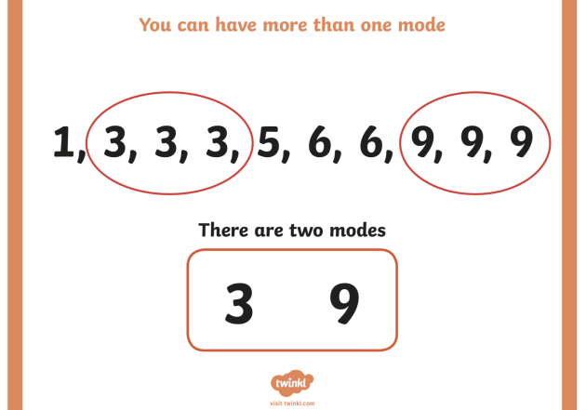
What is mode?
Definition: The mode is the value that appears most frequently in a data set.
Example: In the data set [1, 2, 2, 3, 4], the mode is 2 because it occurs more frequently than any other value.

Slide 3
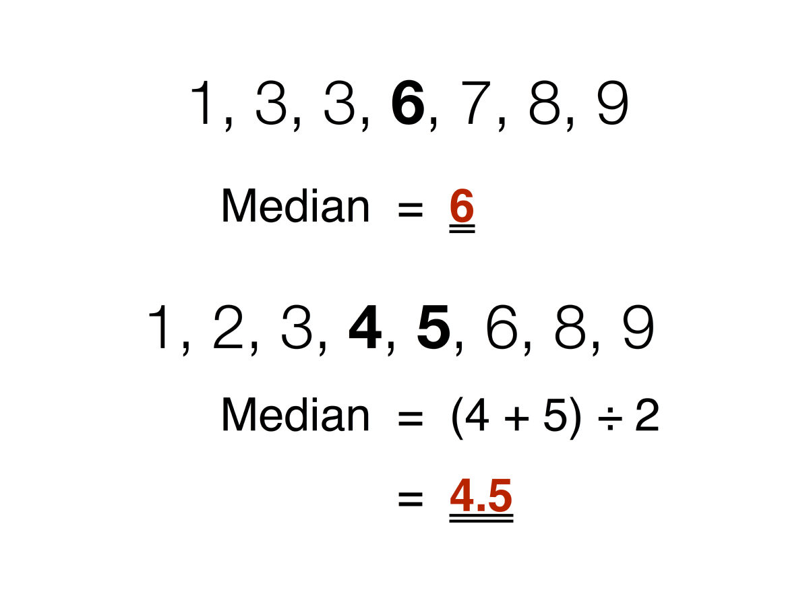
What is median?
In statistics, the median is a measure of central tendency that represents the middle value of a dataset when it is ordered from least to greatest. Here’s a detailed explanation of the median:

Slide 4
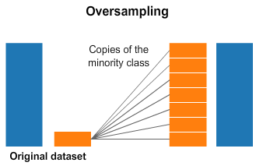
Data balancing?
Oversampling in machine learning data balancing is a technique where minority class samples are duplicated to balance the class distribution in the dataset.

Slide 5
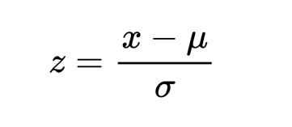
Scaling and Standard Scaler?
Scaling in machine learning is the process of normalizing the range of independent variables or features of data. Standard Scaler standardizes features by removing the mean and scaling to unit variance.

Slide 6
Confusion Matrix and classification report?
predicted Classes
No Yes
Precision = TP / predicted yes
100 / 110 = 0.64
50 (TN) | 10 (FP)
5 (FN) | 100 (TP)
= 60
Recall = TP / actual yes
100 / 105 = 0.95
Actual Classes
= 105
Error rate = FP + FN / total
(10 + 5 ) / 165 = 0.09
= 55
= 110
Accuracy= (TP + TN) / total
(100 + 50) / 165 = 0.91
No Yes

